Slide 1




CyberSec Bootcamp
Lecture – 0x03

Slide 2



MEET YOUR GUIDES :
Zishan Ansari
(Mentor)
CyberSec - GDG
LinkedIn
GitHub

Slide 3

MEET YOUR GUIDES :
Rohit Choudhary
(Instructor)
CyberSec - GDG
LinkedIn
GitHub

Slide 4






BASH SCRIPTING

Slide 5
BASH SCRIPTING-
$> Introduction to Shell Scripting Basics :
$> Shell Scripting is a powerful way to automate and streamline tasks within a Linux
environment by writing and executing commands. It’s invaluable for system administration,
task automation, and enhancing productivity.
$> Types of Shells : Some Popular shells include:
bash (Bourne Again Shell) – most widely used
sh (Bourne Shell)
ksh (Korn Shell)
zsh (Z Shell)

Slide 6
BASH SCRIPTING-
$> echo $0 or echo $SHELL : Run any of these commands to identify your current shell
$> How to create a File and Use It : Creating and editing files using the vi command is a core
skill (vi – vim text editor) for working in Unix and Linux environments. Here’s a step-by-step
guide on creating a file, entering content, and saving it with vi, as well as how to run your
script and view it’s output
$> Opening vi to Create a New File:
1. Open your terminal and type the following command to create or open a file in vi:
“vi my_script .sh” (don’t leave space between name and .sh, I have done it
for clear visibility)

Slide 7
BASH SCRIPTING-
2. If my_script.sh doesn’t exist, vi will create a new file with that name
$> Basic vi Editing Commands : When you open vi, you’re in command mode, where you can
issue commands to vi. Press i to enter insert mode. You can now type content into the file
$> Writing Content in vi : Let’s create a simple script that prints “Hello, World!” and dispalys
the current date and time. With vi in insert mode, type the following script –
#!/bin/bash (or write the location of your shell after “#!” which you will get with “echo $0”)
# This script prints a greeting and the current date and time (this is a comment, after #)
echo “Hello, World!”
echo “The current date and time is:”
date

Slide 8
BASH SCRIPTING-
$> Exit Insert Mode : Press Esc to return to command mode
$> Saving and Exiting in vi : To save the file and exit vi –
Type :wq and press Enter (:wq means “write (save) and quit”)
To save without exiting, type :w and press Enter
To quit without saving changes, type :q! and press Enter
$> Making the Script Executable : Before running your script, you need to make it
executable, In the terminal, type – chmod +x my_script.sh
$> Running the Script and Viewing the Output : ./my_script.sh

Slide 9
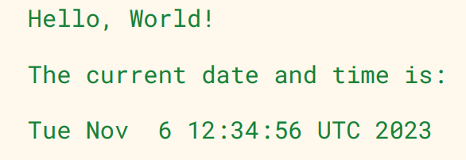
BASH SCRIPTING-
$> Run the Script without making It Executable : bash my_script.sh
$> View the Output : When you execute the script, you should see output similar to this -

Slide 10
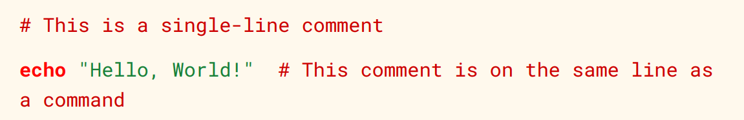
BASH SCRIPTING-
$> So we are done with our very first script, now we know a script is a series of commands
executed sequentially. Now the very first line of a script (#!/bin/bash) is known as Shebang
$> Why Shebang (#!/bin/bash) Matters : This lines tells the system to use Bash to run the
script, ensuring compatibility across Linux environments
$> Comments in Shell Scripting :
1. Single – Line Comments : Use the # symbol at the beginning of a line to create a
single-line comment

Slide 11
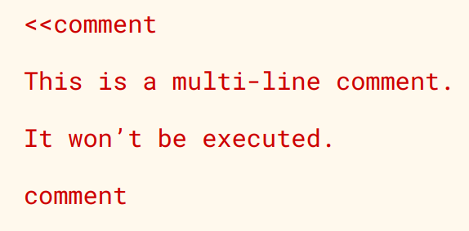
BASH SCRIPTING-
2. Multi-Line Comments : Bash does not have a direct syntax for multi-line comments, but
you can stimulate is using a here-document with <<

Slide 12
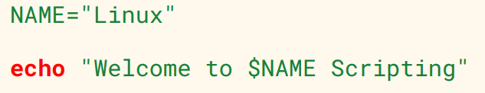
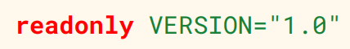
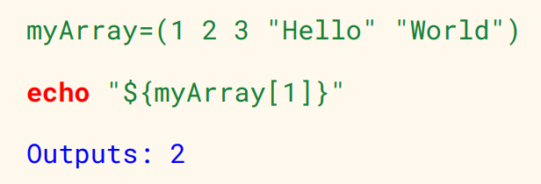
BASH SCRIPTING-
$> Working with Variables and Arrays : Variables and arrays allow data storage and
manipulation in scripts, making automation more flexible
$> Variables : Define a variable and use $ to access its value
$> Constants : Make variables read-only with readonly
$> Arrays : Store multiple values

Slide 13
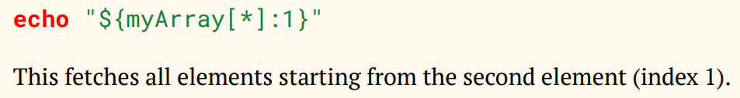
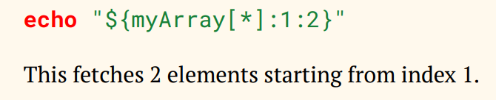
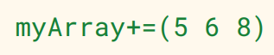
BASH SCRIPTING-
$> Get the length of an array : This returns total number of elements in the array
$> Get specific values from an array : To get values starting from a specific index
$> To get a specific range of values :
$> Update an array (Add new elements) :

Slide 14
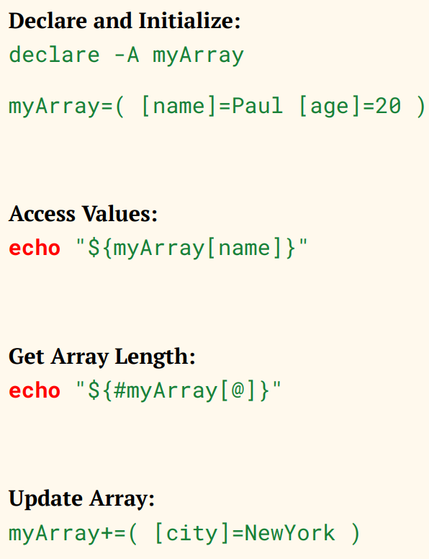
BASH SCRIPTING-
$> Working with Associative Arrays :

Slide 15
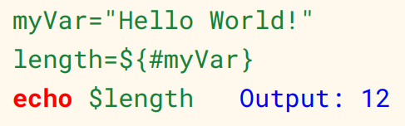
BASH SCRIPTING-
$> String and Arithmetic Operations : str=“Shell Scripting”
$> Length of string : echo ${#str} Outputs – 15
$> Replace in string : echo ${str/Scripting/Programming} Outputs – Shell Programming
$> Extract Substring : echo ${str:6:9} Outputs – Scripting
$> Get the length of a string :

Slide 16
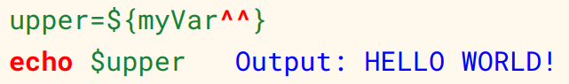
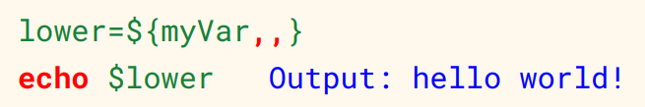
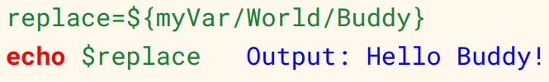
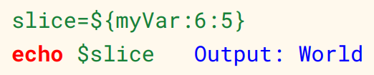
BASH SCRIPTING-
$> Convert to uppercase and lowercase :
$> Replace a substring :
$> Extract a substring (slice) :

Slide 17
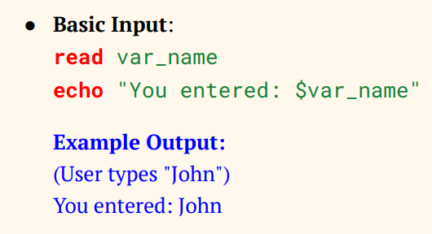
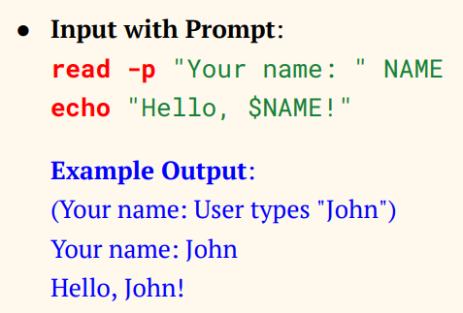
BASH SCRIPTING-
$> User Interactions : Taking Input from the User in Shell Scripting –
Basic Input – Takes input without a prompt
Input with Prompt – Displays a prompt to guide the user

Slide 18
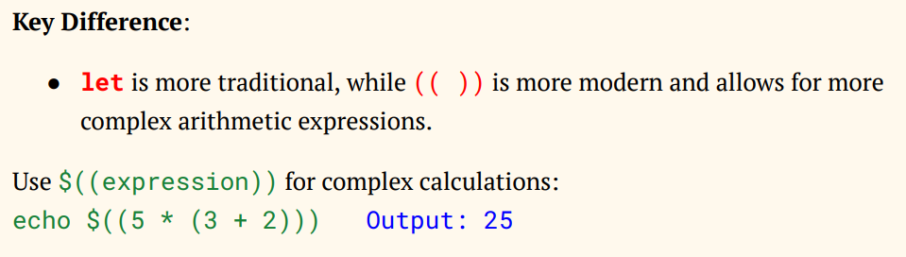
BASH SCRIPTING-
$> Arithmetic Operations :
1. Using the let command – Increment : let a++ (increments value of a by 1)
Assignment with multiplication : let a=5*10
echo $a
output : 50
2. Using (( )) for Arithmetic operations – Increment : ((a++))
Assignment with multiplication : ((a=5*10))
echo $a
output : 50

Slide 19
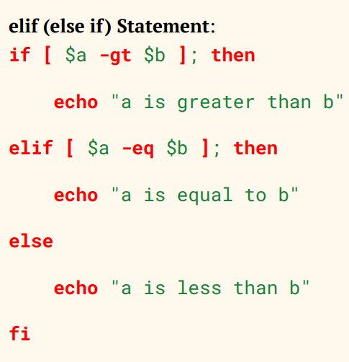
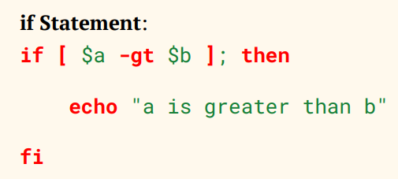
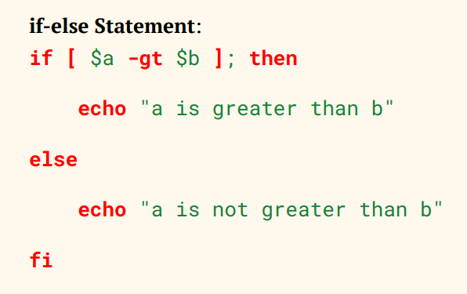
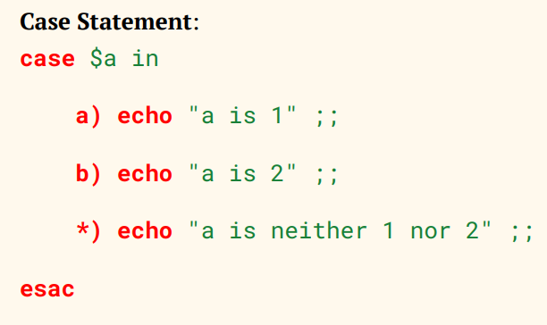
BASH SCRIPTING-
$> Conditional Statements in Shell Scripting :
$> Always put spaces around operators in
conditions

Slide 20
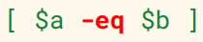
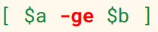
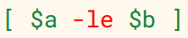
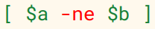
BASH SCRIPTING-
$> Comparison Operators :
1. Equal to -eq or == checks if two values are equal
2. Greater Than or Equal to –ge checks if the left operand is greater than or equal to the right
Less Than or Equal to –le checks if the left operand is less than or equal to the right
3. Not Equal to –ne or !=: checks if two values are not equal
4. Greater Than –gt checks if the left operand is greater than the right
Less Than –lt checks if the left operand is less than the right

Slide 21
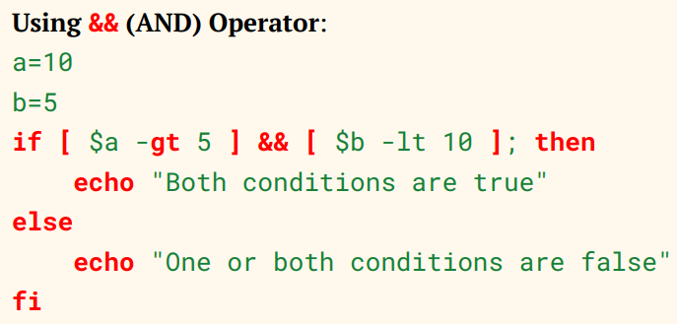
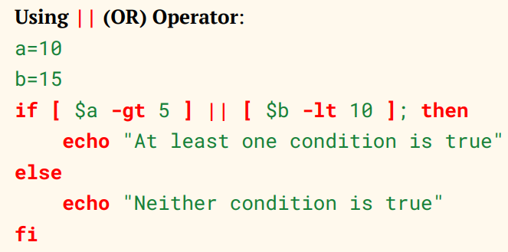
BASH SCRIPTING-
$> Logical Operators :
The && ensures both conditions must be true
The || checks the second condition if the first fails

Slide 22
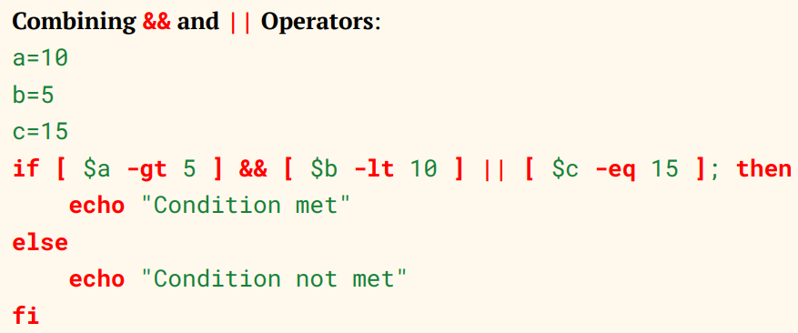
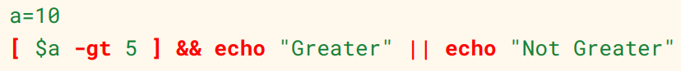
BASH SCRIPTING-
$> Logical Operators :
$> Ternary Operator (One-liner If-Else) : A simple way to write an if-else statement in
one line
If $a –gt 5 is true, it prints “Greater”
Otherwise, it prints “Not Greater”

Slide 23
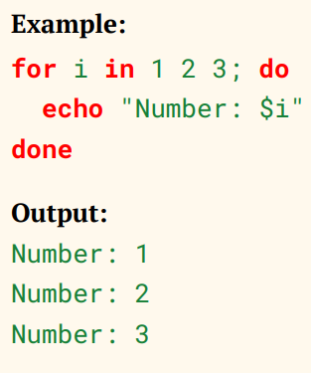
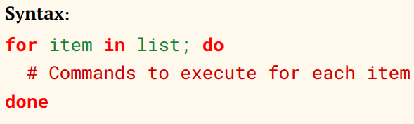
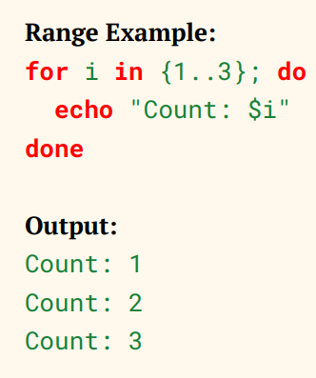
BASH SCRIPTING-
$> For Loop : The for loop iterates over a list or a range of values and performs actions for
each item

Slide 24
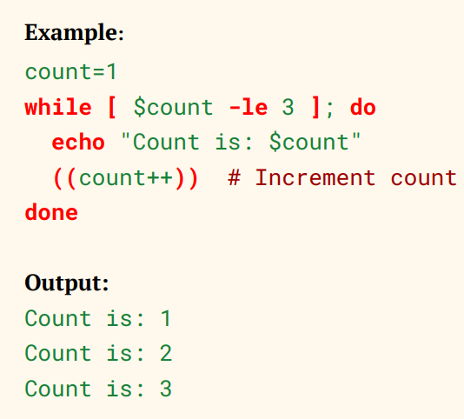
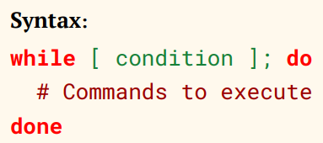
BASH SCRIPTING-
$> While Loop : The while loop runs as long as specified conditions is true

Slide 25
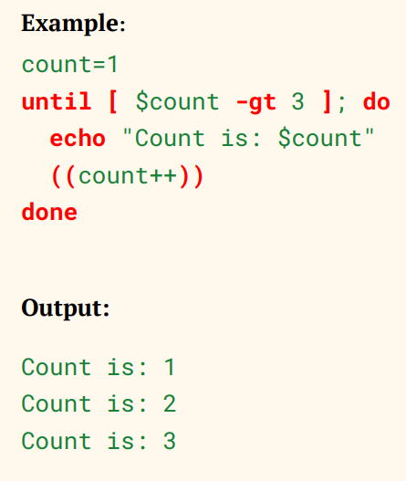
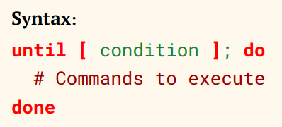
BASH SCRIPTING-
$> Until Loop : The Until loop continues to execute until the condition becomes true

Slide 26
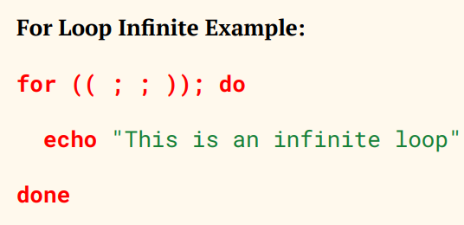
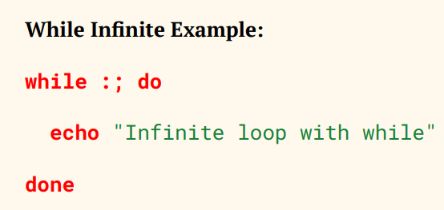
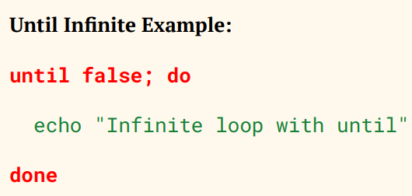
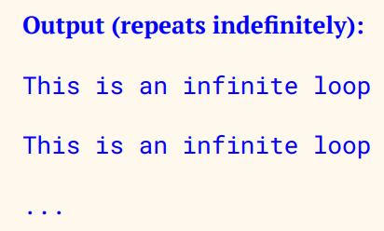
BASH SCRIPTING-
$> Infinite Loop : An Infinite loop continues running indefinitely until it is manually
stopped (e.g, using ctrl+c)

Slide 27
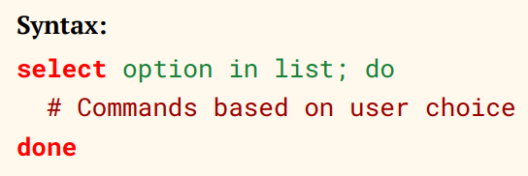
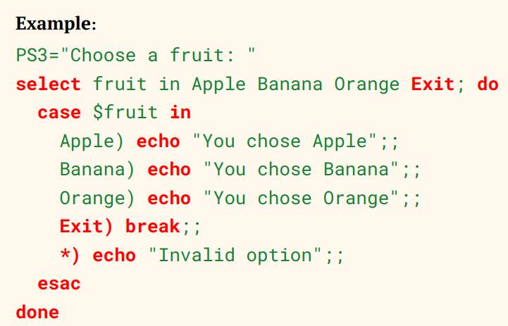
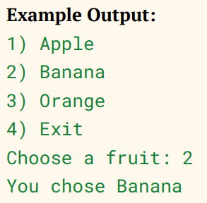
BASH SCRIPTING-
$> Select Loop: The select loop creates a simple menu system, which allows users to select
an option from a list. It’s useful when you need a user-driven selection process
Explanation:
PS3 sets the prompt message
The select loop displays options,
and each selection runs the corresponding case statement
The break statement exits the loop when user selects “Exit”

Slide 28
BASH SCRIPTING-
$> Functions :
1. Defining Functions : You can define a function using either of these two syntaxes –
function function_name {…} or function_name( ) {…}
2. Basic Function : Functions are used to encapsulate reusable blocks of code, Eg –
greet ( ) {
echo “Hello, welcome to Winter Bootcamp by GDG on campus ADGIPS!”
}
greet #calling the function

Slide 29
BASH SCRIPTING-
3. Functions with Parameters : Functions can accept arguments, which are accessed via $1,
$2, etc
greet_user ( ) {
echo “Hello, $1!”
}
greet_user “Dev”
4. Return Values : Function return values via echo, and the output can be captured
add_numbers ( ) {
result=$(($1+$2))
echo $result
}
sum=$(add_numbers 3 5)
echo “The sum is: $sum”

Slide 30
BASH SCRIPTING-
5. Conditional Logic and Loops : Functions can include conditions and loops
check_even ( ) {
if (($1 % $2 == 0)); then
echo “$1 is even”
else
echo “$1 is odd”
fi
}
check_even 7
Output: “7 is odd”

Slide 31
BASH SCRIPTING-
6. Recursion : Functions can call themselves recursively
factorial ( ) {
if [ $1 -le 1 ]; then
echo 1
else
prev=$(factorial $(( $1 – 1 )))
echo $(( $1 * prev ))
fi
}
result=$(factorial 5)
echo “Factorial of 5 is: $result”

Slide 32
BASH SCRIPTING-
7. Default Values : Set default values for arguments using ${1 : -default_value}
greet ( ) {
local name=${1 :-Guest }
echo ”Hello, $name!”
}
greet “Dev” Output : “Hello, Dev!”
greet Output : “Hello, Guest!”

Slide 33
BASH SCRIPTING-
8. Passing Arguments by Reference : Bash doesn’t directly support passing by reference but
can simulate it using eval
modify_value ( ) {
eval $1=\$2
}
modify_value var 100
echo “The value of var is now: $var”
Output : “The value of var is now: 100”

Slide 34
BASH SCRIPTING-
9. Arguments Passing : You can pass arguments to functions, and they can be accessed inside
the function
Positional Arguments ($1, $2, $3, etc.)
These represent Individual arguments passed to a function or a script
$1 is the first argument, $2 is the second, and so on
Example:
greet( ) {
echo “Hello, $1! You are $2 years old.”
}
greet “Dev” 18 Output: Hello, Dev! You are 18 years old.

Slide 35
BASH SCRIPTING-
All Arguments ($@)
This represents all the arguments passed to a function or script
Each argument is treat as a separate word, which is especially useful when looping over
the arguments
Example:
print_all( ) {
for arg in “$@”; do Output:
echo “$arg” Apple
done Banana
} Cherry
print_all “Apple” “Banana” “Cherry”

Slide 36
BASH SCRIPTING-
All Arguments as a Single String ($*)
Similar to $@, but it treats all arguments as a single string, meaning spaces between
arguments may be lost
Example:
print_all_as_string( ) {
echo “$*”
}
print_all_as_string “Apple” “Banana” “Cherry”
Output : Apple Banana Cherry

Slide 37
BASH SCRIPTING-
Number of Arguments ($#)
This gives the count of the arguments passed to a function or script
Example:
count_args( ) {
echo “Number of arguments: $#”
}
count_arg “Apple” “Banana” “Cherry”
Output : Number of arguments: 3

Slide 38
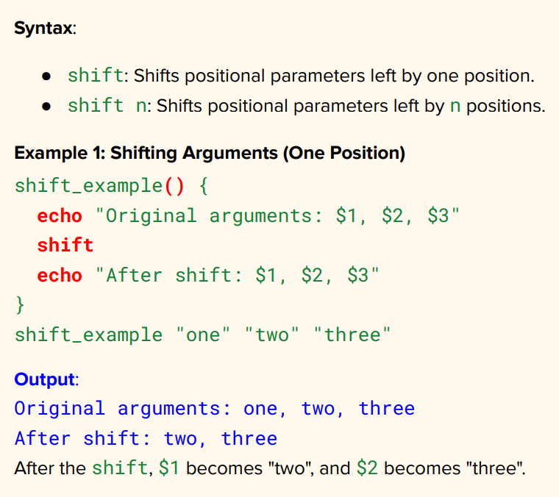
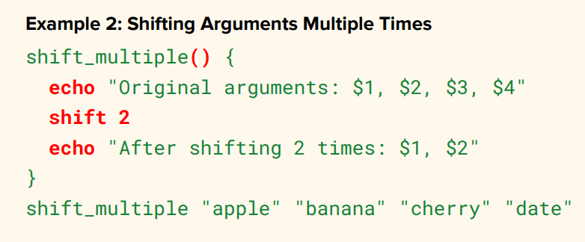
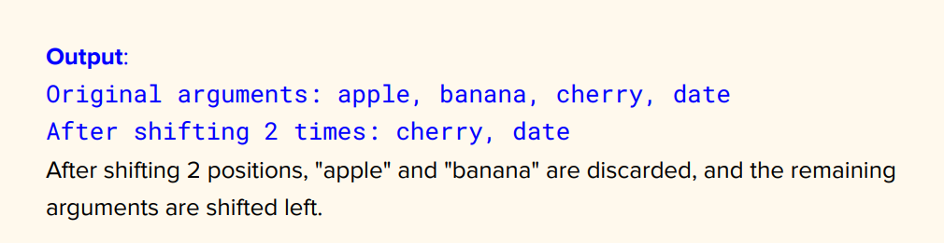
BASH SCRIPTING-
$> Shift Operator in Bash : The shift command in bash allows you to move (shift) the
positional parameters (arguments) passed to a script or function. Here’s a brief explanation
of how it works –

Slide 39
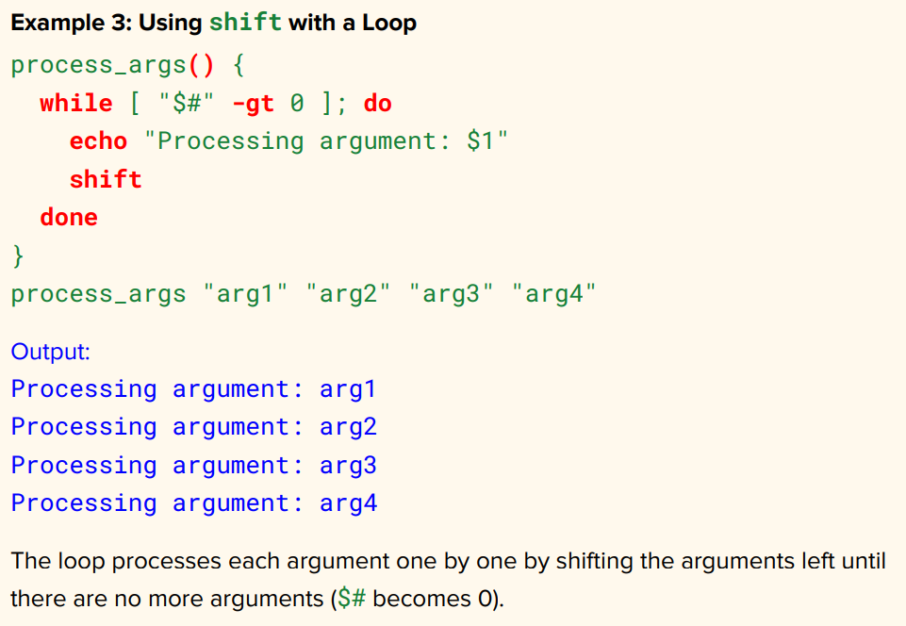
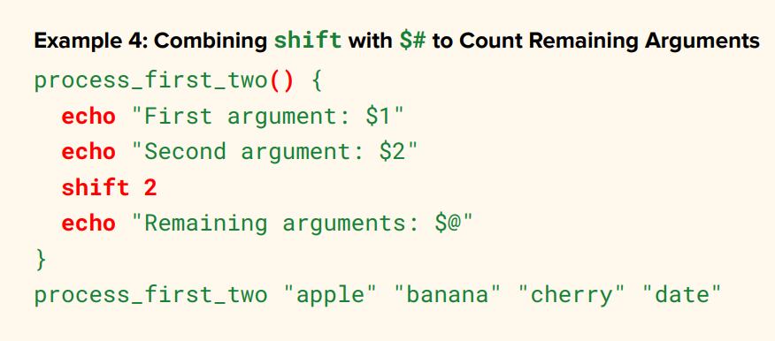
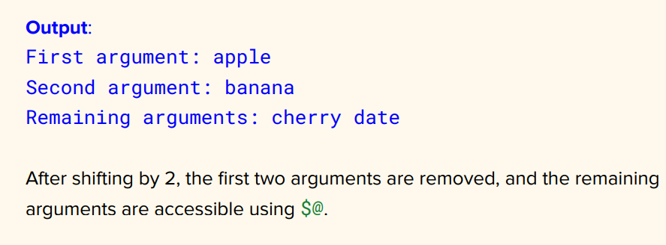
BASH SCRIPTING-

Slide 40
BASH SCRIPTING-
$> Break Statement : Exits a loop prematurely (Syntax – break or break “number”)Example–
for i in {1 . . 5}; do
if [ $i –eq 3 ]; then break; fi
echo $i
done
Output : Loops until i=3, then exits
$> Continue Statement : Skips the current loop iteration and moves to the next one
for i in {1 . . 5}; do
if [ $i –eq 3 ]; then continue; fi
echo $i
done
Output : Skips iteration when i=3

Slide 41
BASH SCRIPTING-
$> Break and Continue in Nested Loops : Example–
for i in {1 . . 3}; do
for j in {1 . . 3}; do
if [ $i –eq 2 ] && [ $j –eq 2 ]; then break 2; fi
echo ”i=$i, j=$j”
done
done
Output : Exits both loops when i=2 and j=2
$> exit Command : Exits a script with a status code (0 for success, non-zero
For error), syntax is exit <exit_code> Eg – exit 1 #Exits with an error

Slide 42


BASH SCRIPTING-
$> Seq Command : The seq command in Linux is used to generate a sequence of numbers.
It’s commonly used in shell scripting or on the command line to generate numbers for loops,
lists or ranges. Basic Syntax – seq [options] <start> <end>
Start : The starting number of the sequence
End : The ending number of the sequence
Examples –
Example 2
Example 1

Slide 43



BASH SCRIPTING-
Example 4
Example 3

Slide 44


BASH SCRIPTING-
Example 5
Example 6

Slide 45
BASH SCRIPTING-
$> Brace Expansion : It is a feature in the shell (especially Bash) that allows you to generate
multiple text strings from a single expression. It is typically used to create lists of strings or
numbers, or to generate filenames with multiple variations. Brace expansion is a simple and
efficient way to generate multiple values without having to manually list them
Basic syntax – {item1, item2, item3}, This will generate a list containing the individual items within the
braces
Creating a List of words : You can generate a list of words by expanding a comma-separated list
echo {apple, banana, cherry}
Output : apply banana cherry
Range of Numbers : echo {1 . . 5}
Output : 1 2 3 4 5

Slide 46
BASH SCRIPTING-
Range of Letters : You can also create a range of letters
echo {a . . e}
Output : a b c d e
Range with Step Size : You can specify a step size by including it after the range
echo {1 . . 10 . . 2}
Output : 1 3 5 7 9
Combining Text with Variables : You can use brace expansion to combine static text with var
echo file{1 . . 3}.txt
Output : file1.txt file2.txt file3.txt

Slide 47
BASH SCRIPTING-
Nested Brace Expansion : You can also nest brace expansions to create more complex patterns
echo {A,B}{1,2}
Output : A1 A2 B1 B2
Multiple Elements in a Single Expansion :
echo {A,B,C}{1,2,3}
Output : A1 A2 A3 B1 B2 B3 C1 C2 C3
Files and Directories : You can use brace expansion to generate multiple files or directory
names
mkdir dir{1,2,3}
Output : This will create the Directories dir1, dir2, and dir3

Slide 48
BASH SCRIPTING-
Important Points :
Brace expansion happens before any other shell operations like variable expansion or command
substitution
It is not the same as parameter expansion or globbing. It is handled directly by the shell before the
command is executed
No spaces between commas in the braces. It should be {item1,item2} instead of {item1, item2}

Slide 49
BASH SCRIPTING-
$> getopts command : The getopts command is used In shell scripting (primarily in Bash) to
parse command-line options (flags) and arguments passed to a script. It provides a way to
handle options and arguments in a structured and consistent manner, making your script
more flexible and user-friendly. Basic syntax – getopts “option_string” variable
option_string : A string of valid option letters. If an option requires an argument, you
append a colon (:) after the letter (e.g., a: means option a expects and argument)
variable : The variable where the parsed option will be stored
How getopts Works:
getopts process command-line arguments one by one
It sets the value of the variable to the current option letter
If the option requires an argument, getopts will assign that argument to a special
variable, usually $0PTARG

Slide 50


BASH SCRIPTING-
Example 2
Example 1

Slide 51


BASH SCRIPTING-
Example 3

Slide 52


BASH SCRIPTING-
Example 4

Slide 53

BASH SCRIPTING-
$> Exiting when No Arguments Are Provided: If no arguments are given or getopts finds a
missing or incorrect argument, it will return ? , which can be caught to display an error or
usage message
Key Points : Advantages:
getopts is used to process options 1. Provides a simple and standard way to
one by one. handle command-line options.
$OPTARG contains the value for 2. Makes scripts more user-friendly and
options that take arguments. interactive.
getopts does not handle long options
directly you will need to process them
Manually if needed
Return codes:
0: The option was successfully processed.
1: Invalid option or missing argument.

Slide 54
BASH SCRIPTING-
1. basename :
Strips the directory path and returns only the filename. You can also remove a file
extension if specified
Example : basename /home/user/file.txt file.txt , and
basename /home/user/file.txt .txt file
2. dirname :
Strips the filename and returns the directory path
Example: dirname /home/user/file.txt /home/user

Slide 55

BASH SCRIPTING-
3. realpath :
Resolves and returns the absolute path of a file or directory, resolving symbolic links.
Example : realpath file.txt /home/user/Documents/file.txt
4. File/Directory Existence Checks :
-d <folder> : checks if a directory exists
! –d <folder> : checks if a directory does not exist
-f <file> : checks if a file exists
! –f <file> : checks if a file does not exist

Slide 56

BASH SCRIPTING-
5. Random and UID :
Random : Generates a random number between 0 and 32767
UID : Stores the user ID of the currently logged-in user

Slide 57
BASH SCRIPTING-
$> To continue running even after the terminal is closed, you can use nohup (short for
“no hang up”). This command is useful for running long-running processes or scripts in the
background, even if the terminal session is closed or disconnected
How to Use nohup : To run a script in the background and keep it running after closing
terminal, use the nohup command followed by the script or command and an & to run it
in the background. Example: nohup bash myscript.sh &
this will run myscript.sh in the background, and the terminal can be close without
interrupting the execution of the script. The standard output will be redirected to a
file called nohup.out unless you specify a different file

Slide 58
BASH SCRIPTING-
Redirecting Output : If you don’t want to see the output in the nohup.out file, you can
redirect it to /dev/null
Example: nohup ./myscript.sh > /dev/null 2>&1 &

Slide 59
BASH SCRIPTING-
Project: Simple Calculator –
This calculator will support basic arithmetic operations like addition, subtraction, multiplication,
and division. The user can input the operation and two numbers, and the script will return the
result.

Slide 60




THANK YOU

